Slide 1
Preparing Your Final Report for ECE 445, Senior Design
Aaron Geiger, Ph.D., M.S.
ECE Editorial Services
ageiger2@illinois.edu

Slide 2
Resources on ECE 445 Web Site
Home➔Guidelines➔ Assignments and Grading➔Final Report
“Preparing Your Final Report for ECE 445” (final report guidelines)
Word Template (also LaTeX)
Other resources

Slide 3
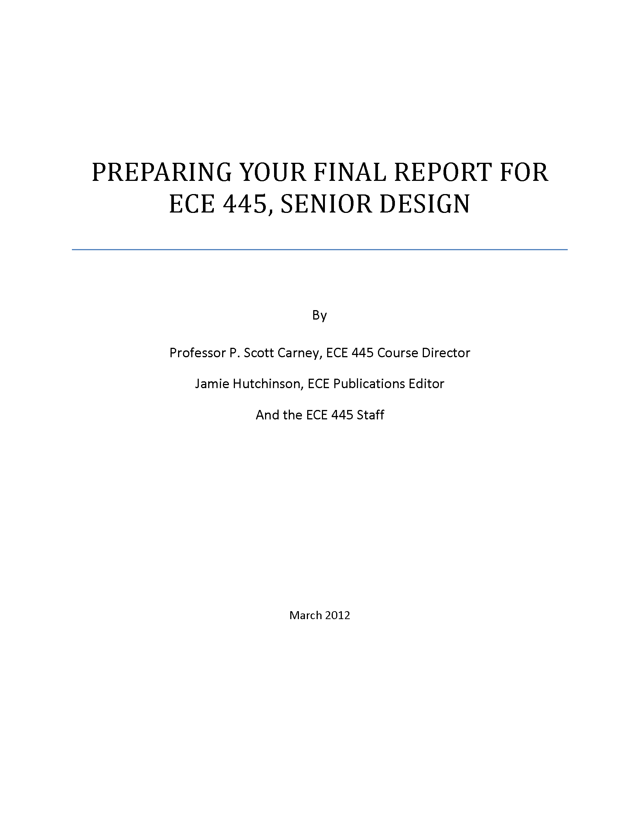

Slide 4
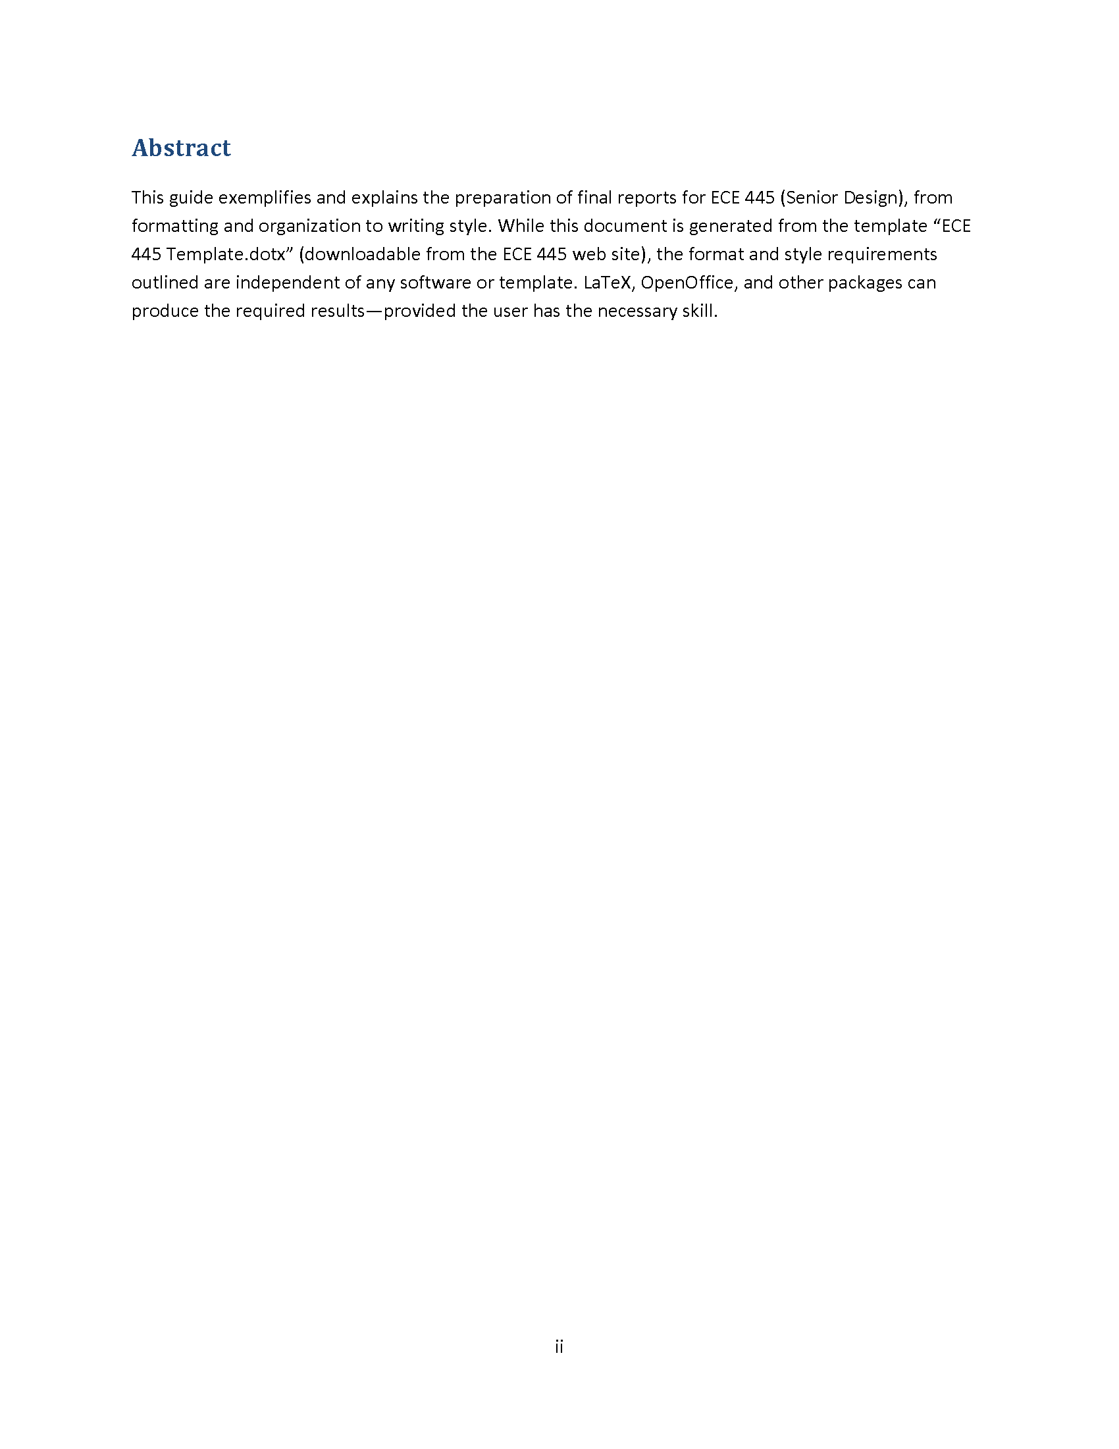

Slide 5
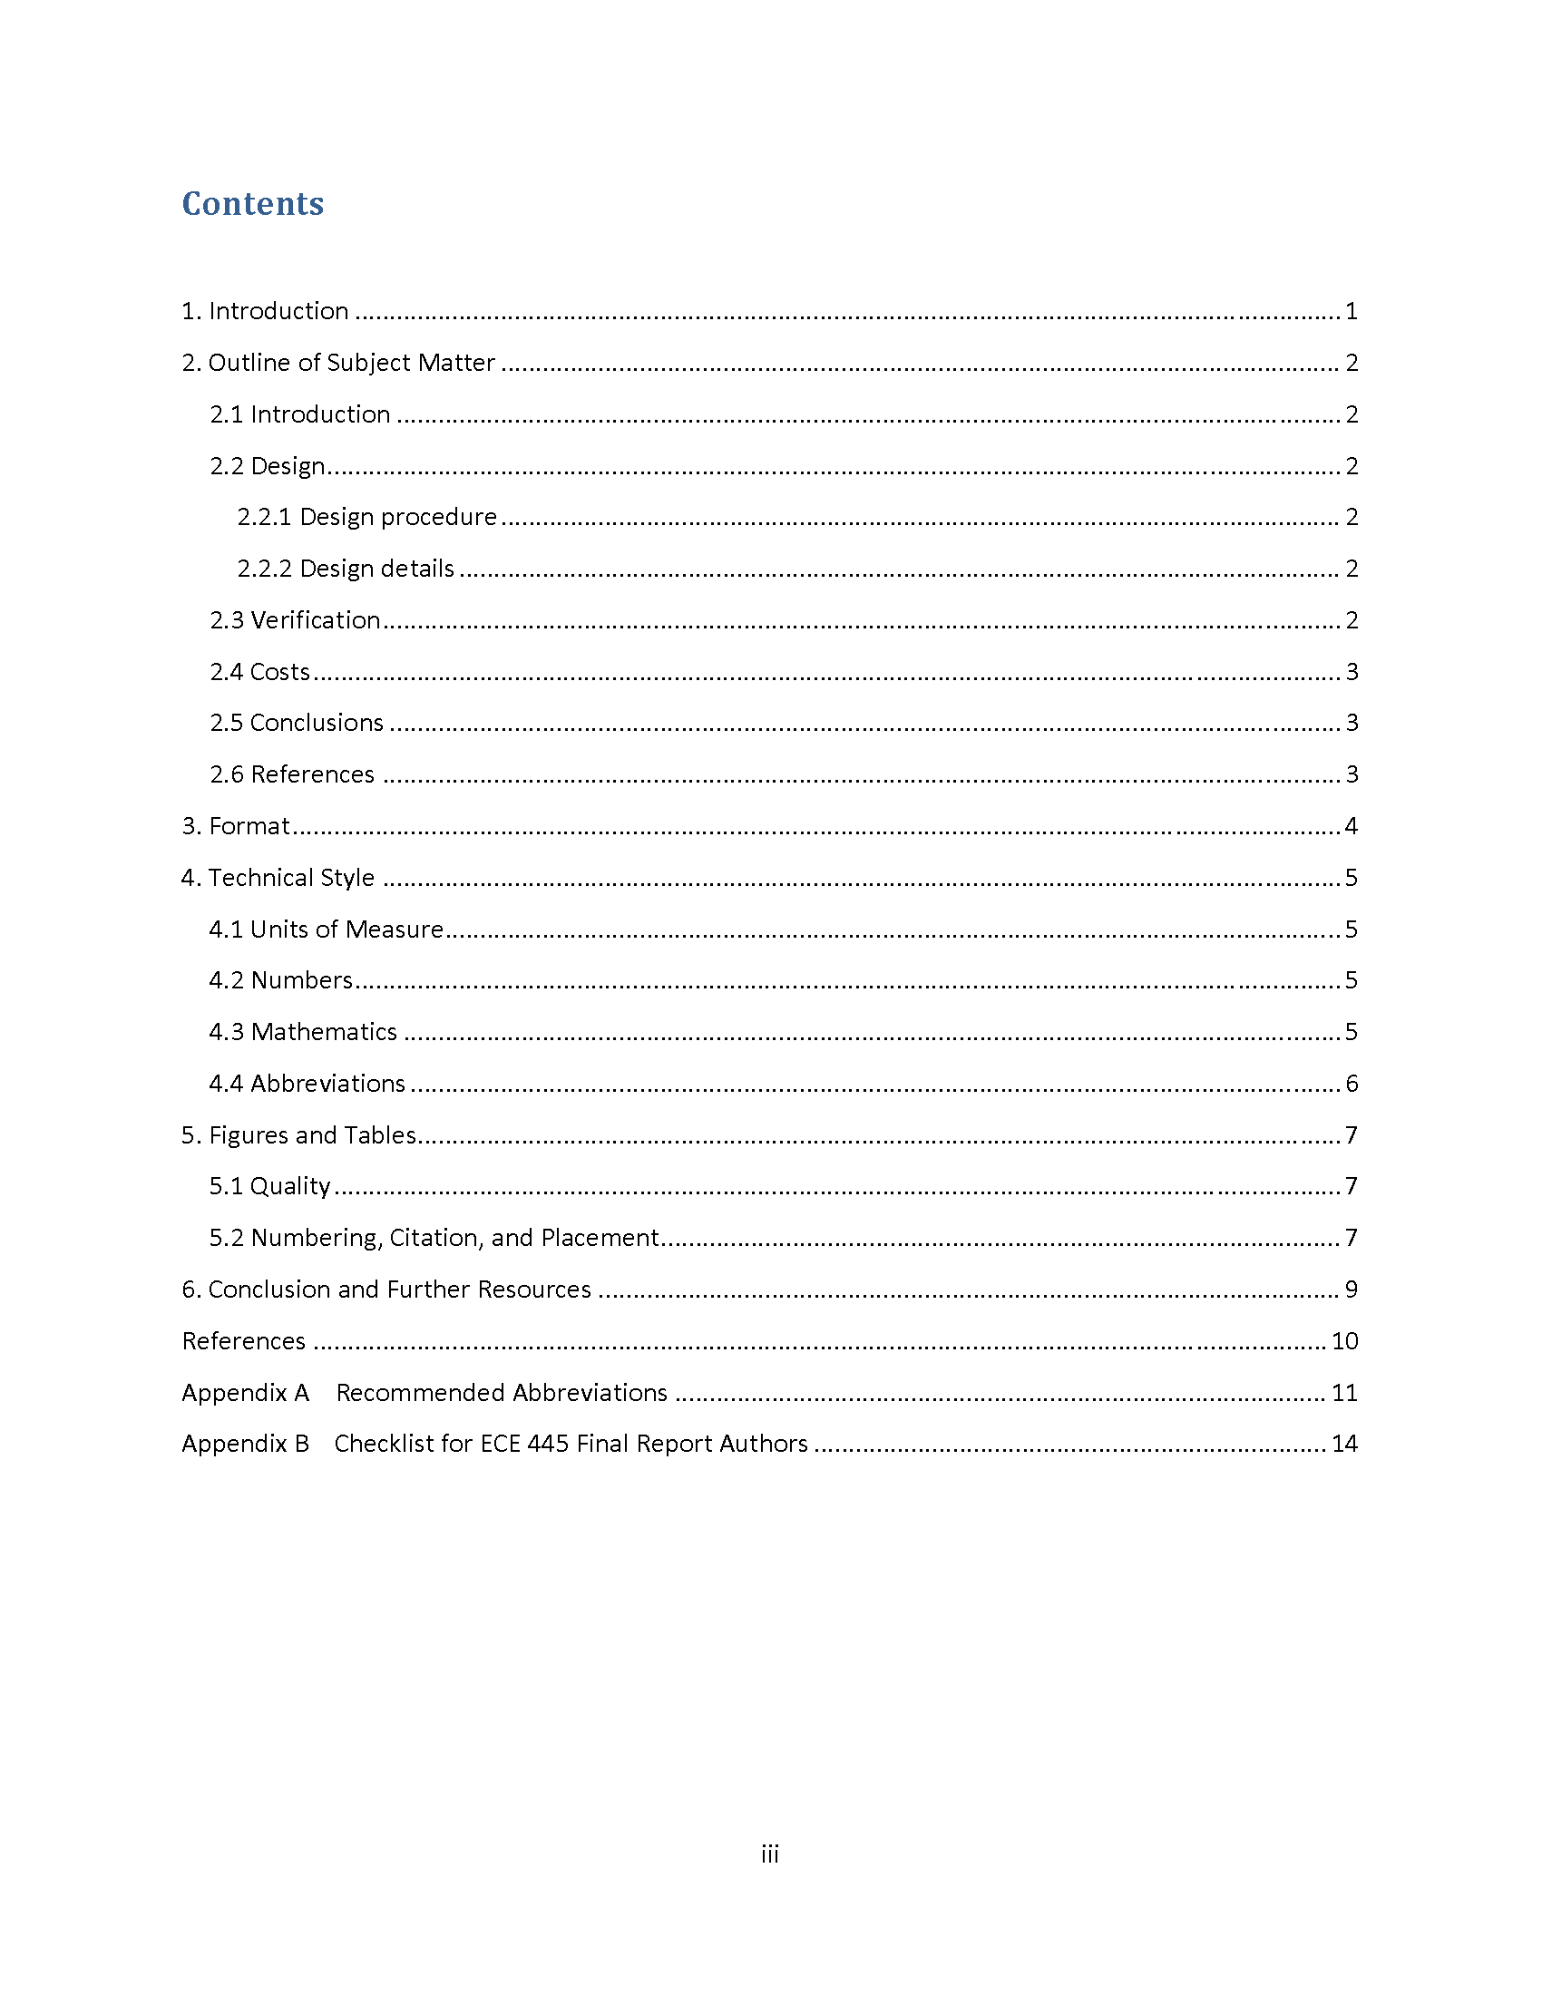

Slide 6
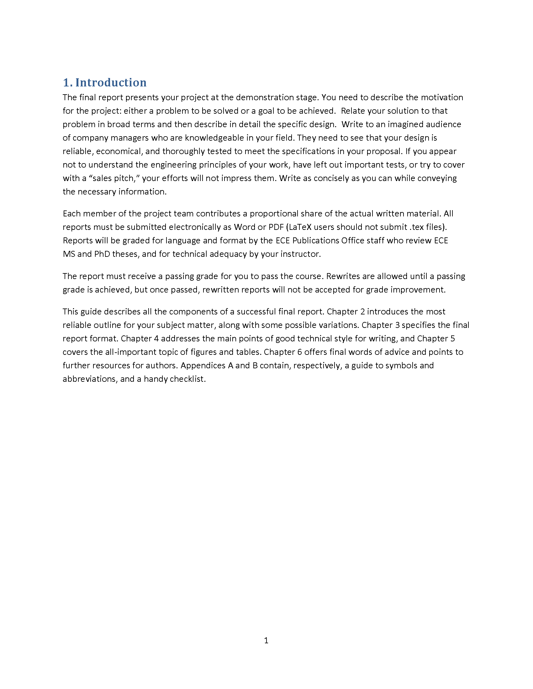

Slide 7
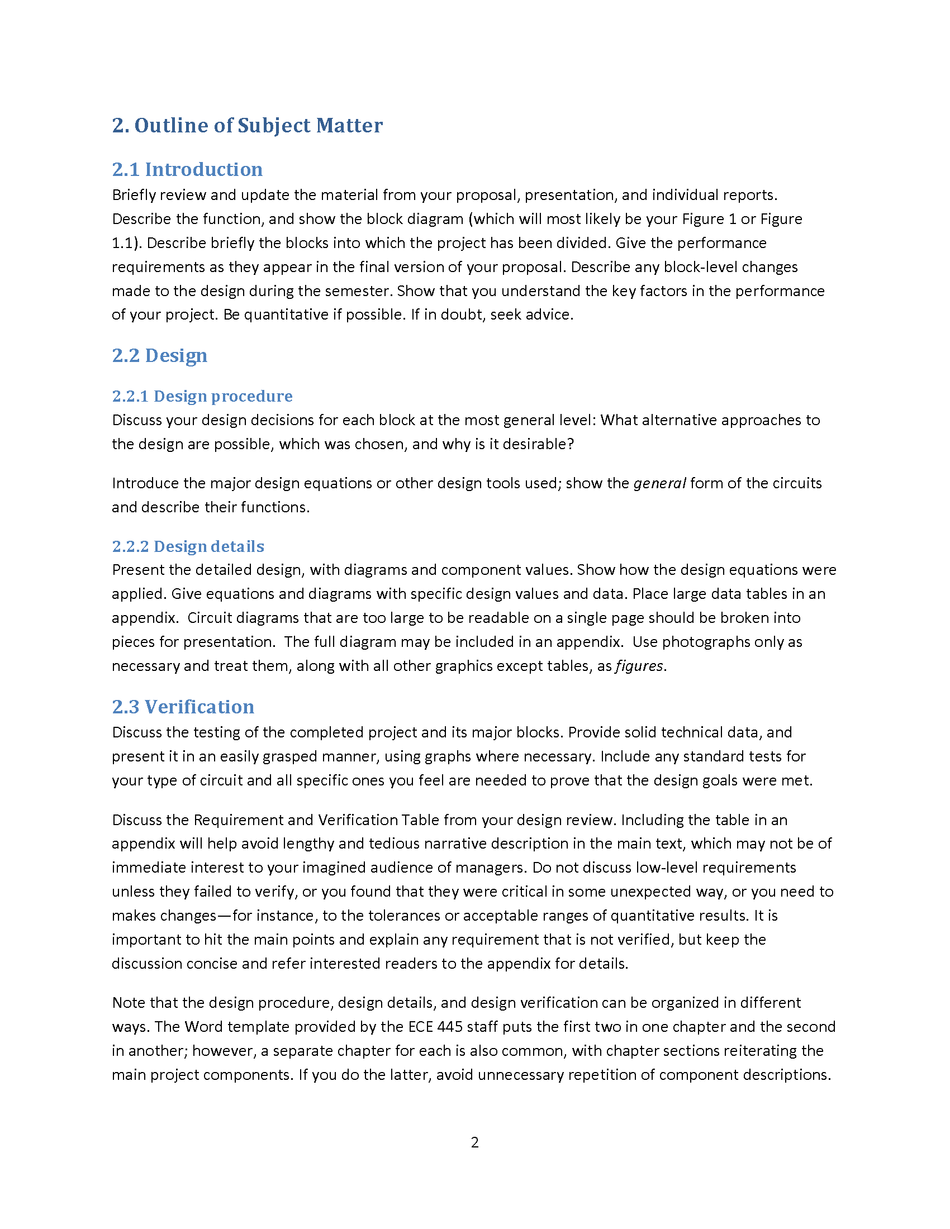

Slide 8
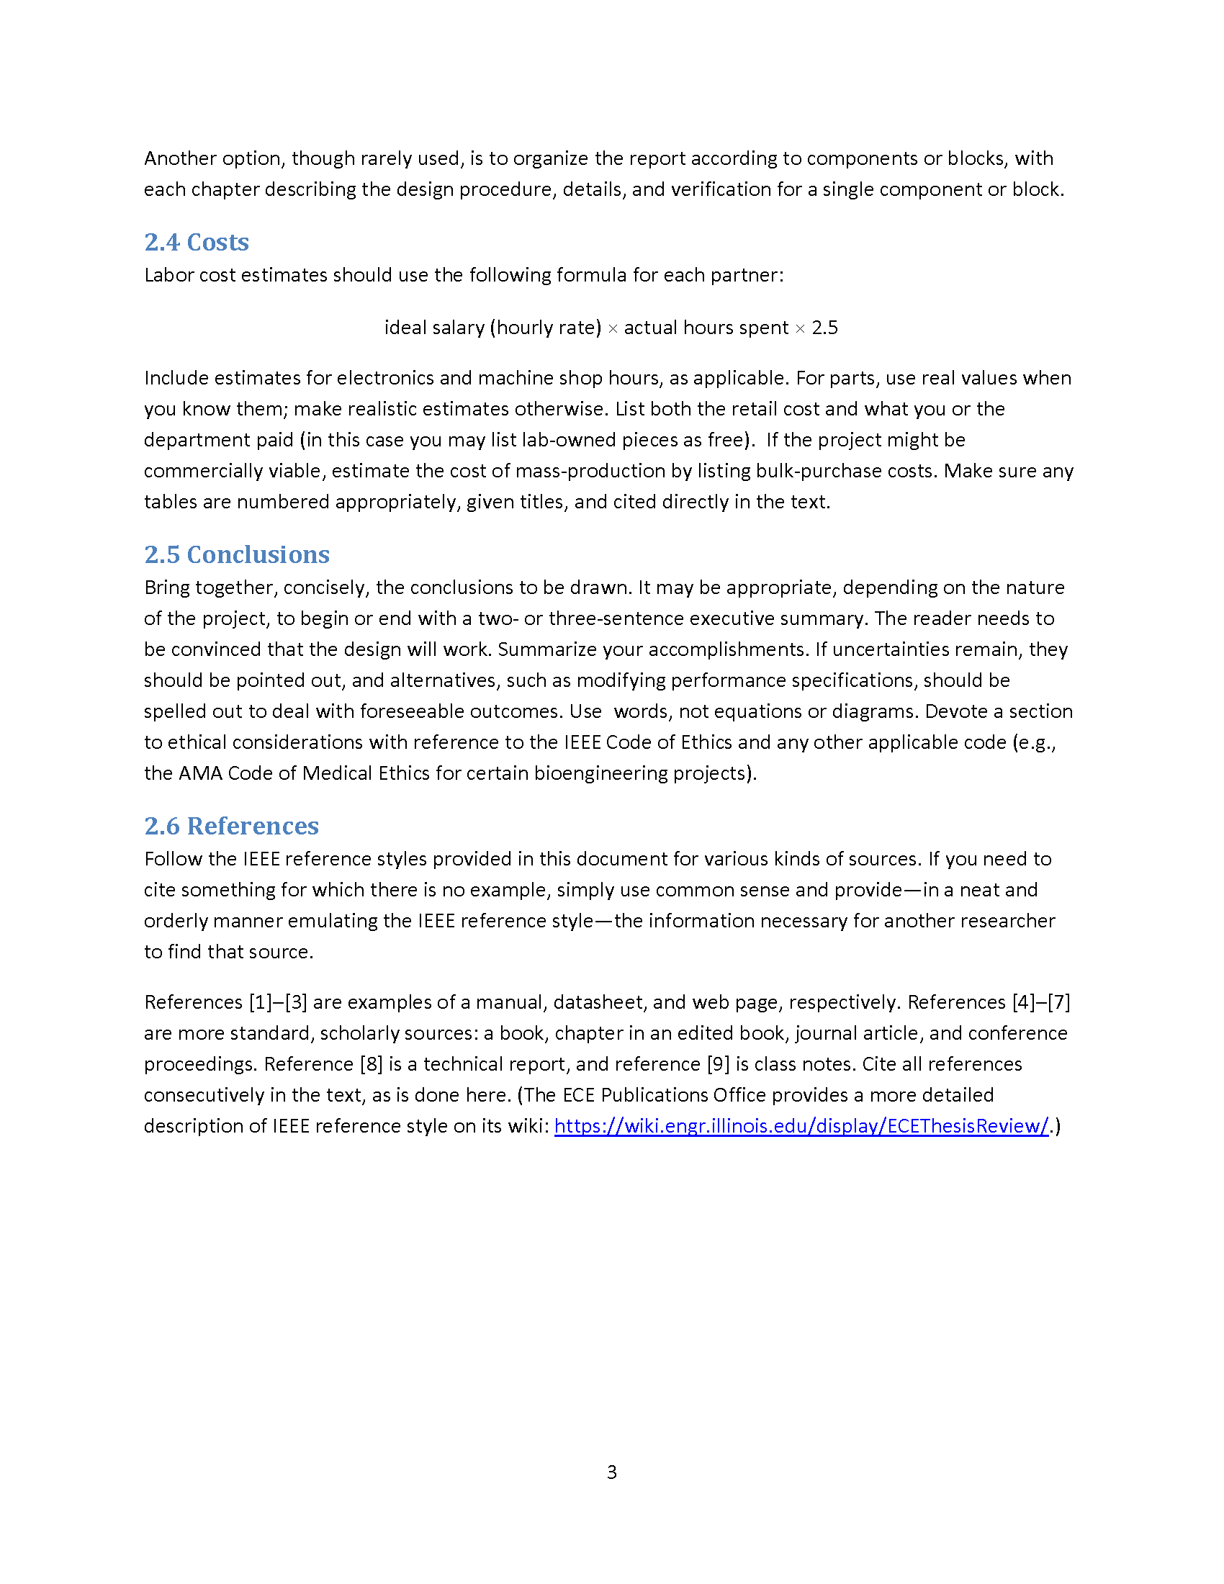

Slide 9
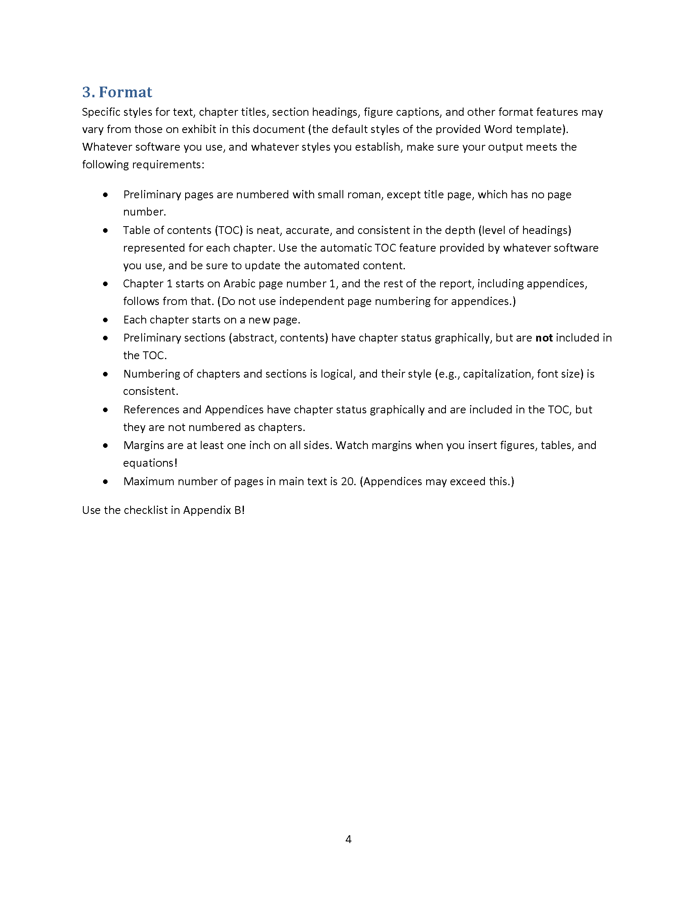

Slide 10
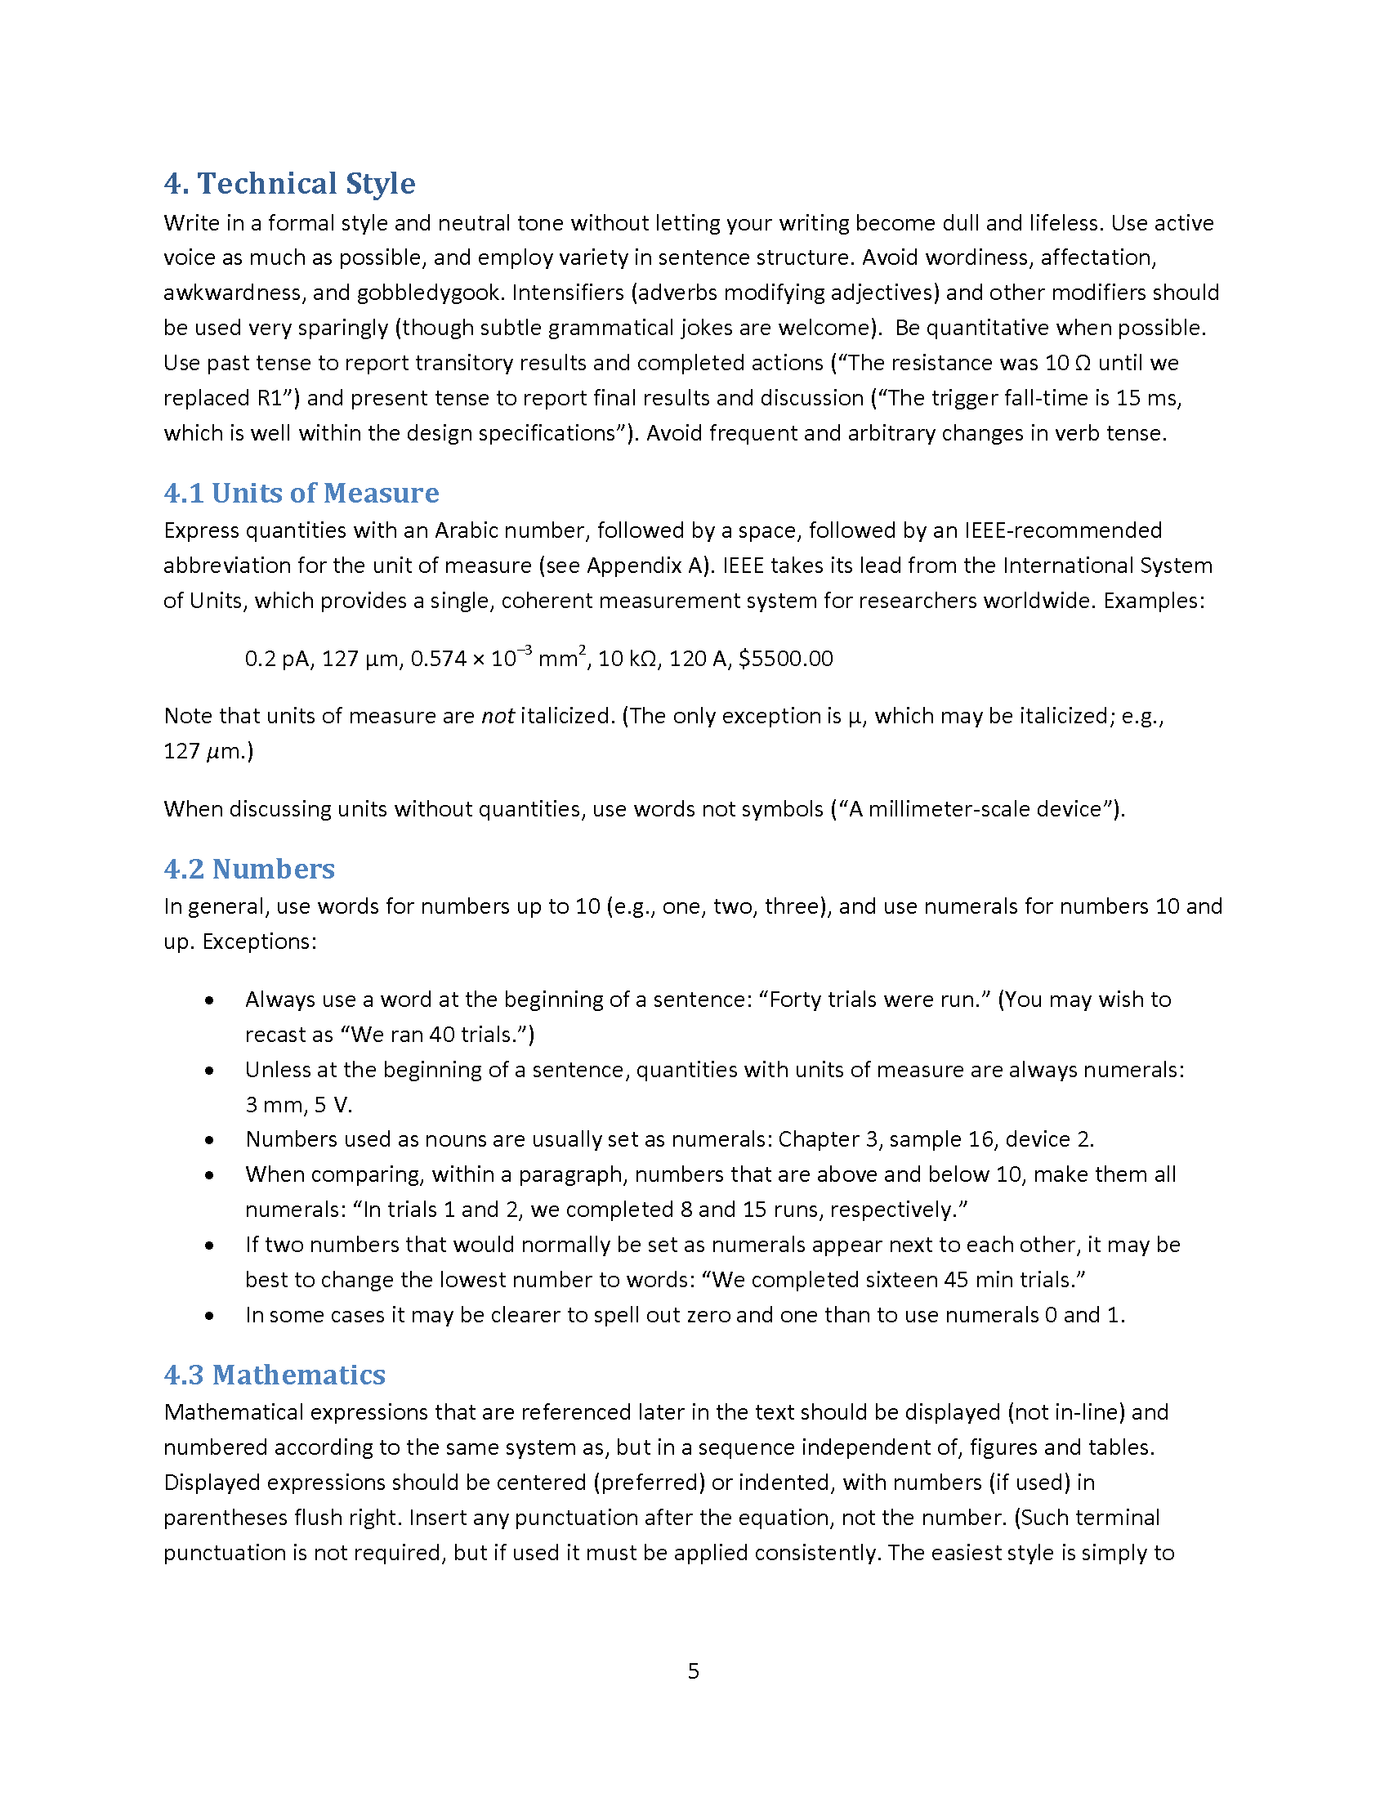

Slide 11
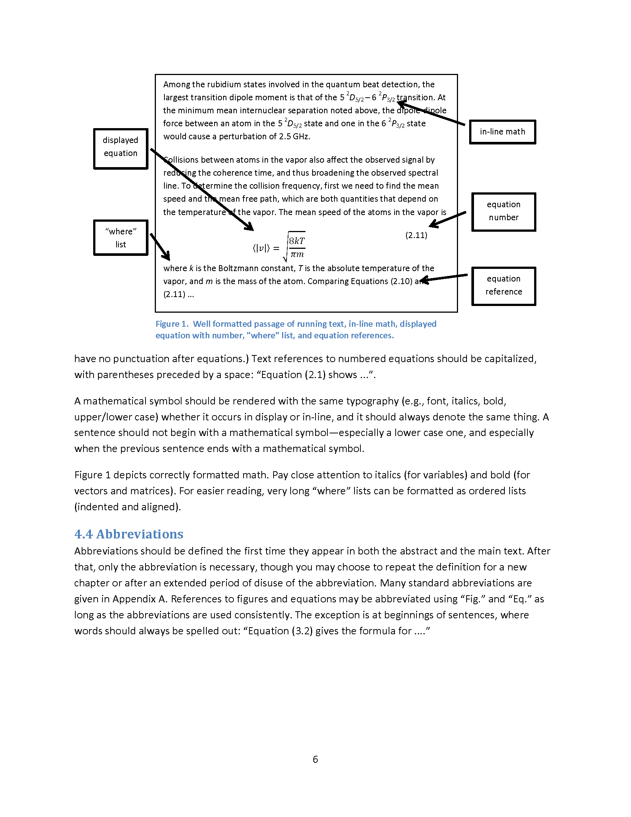

Slide 12
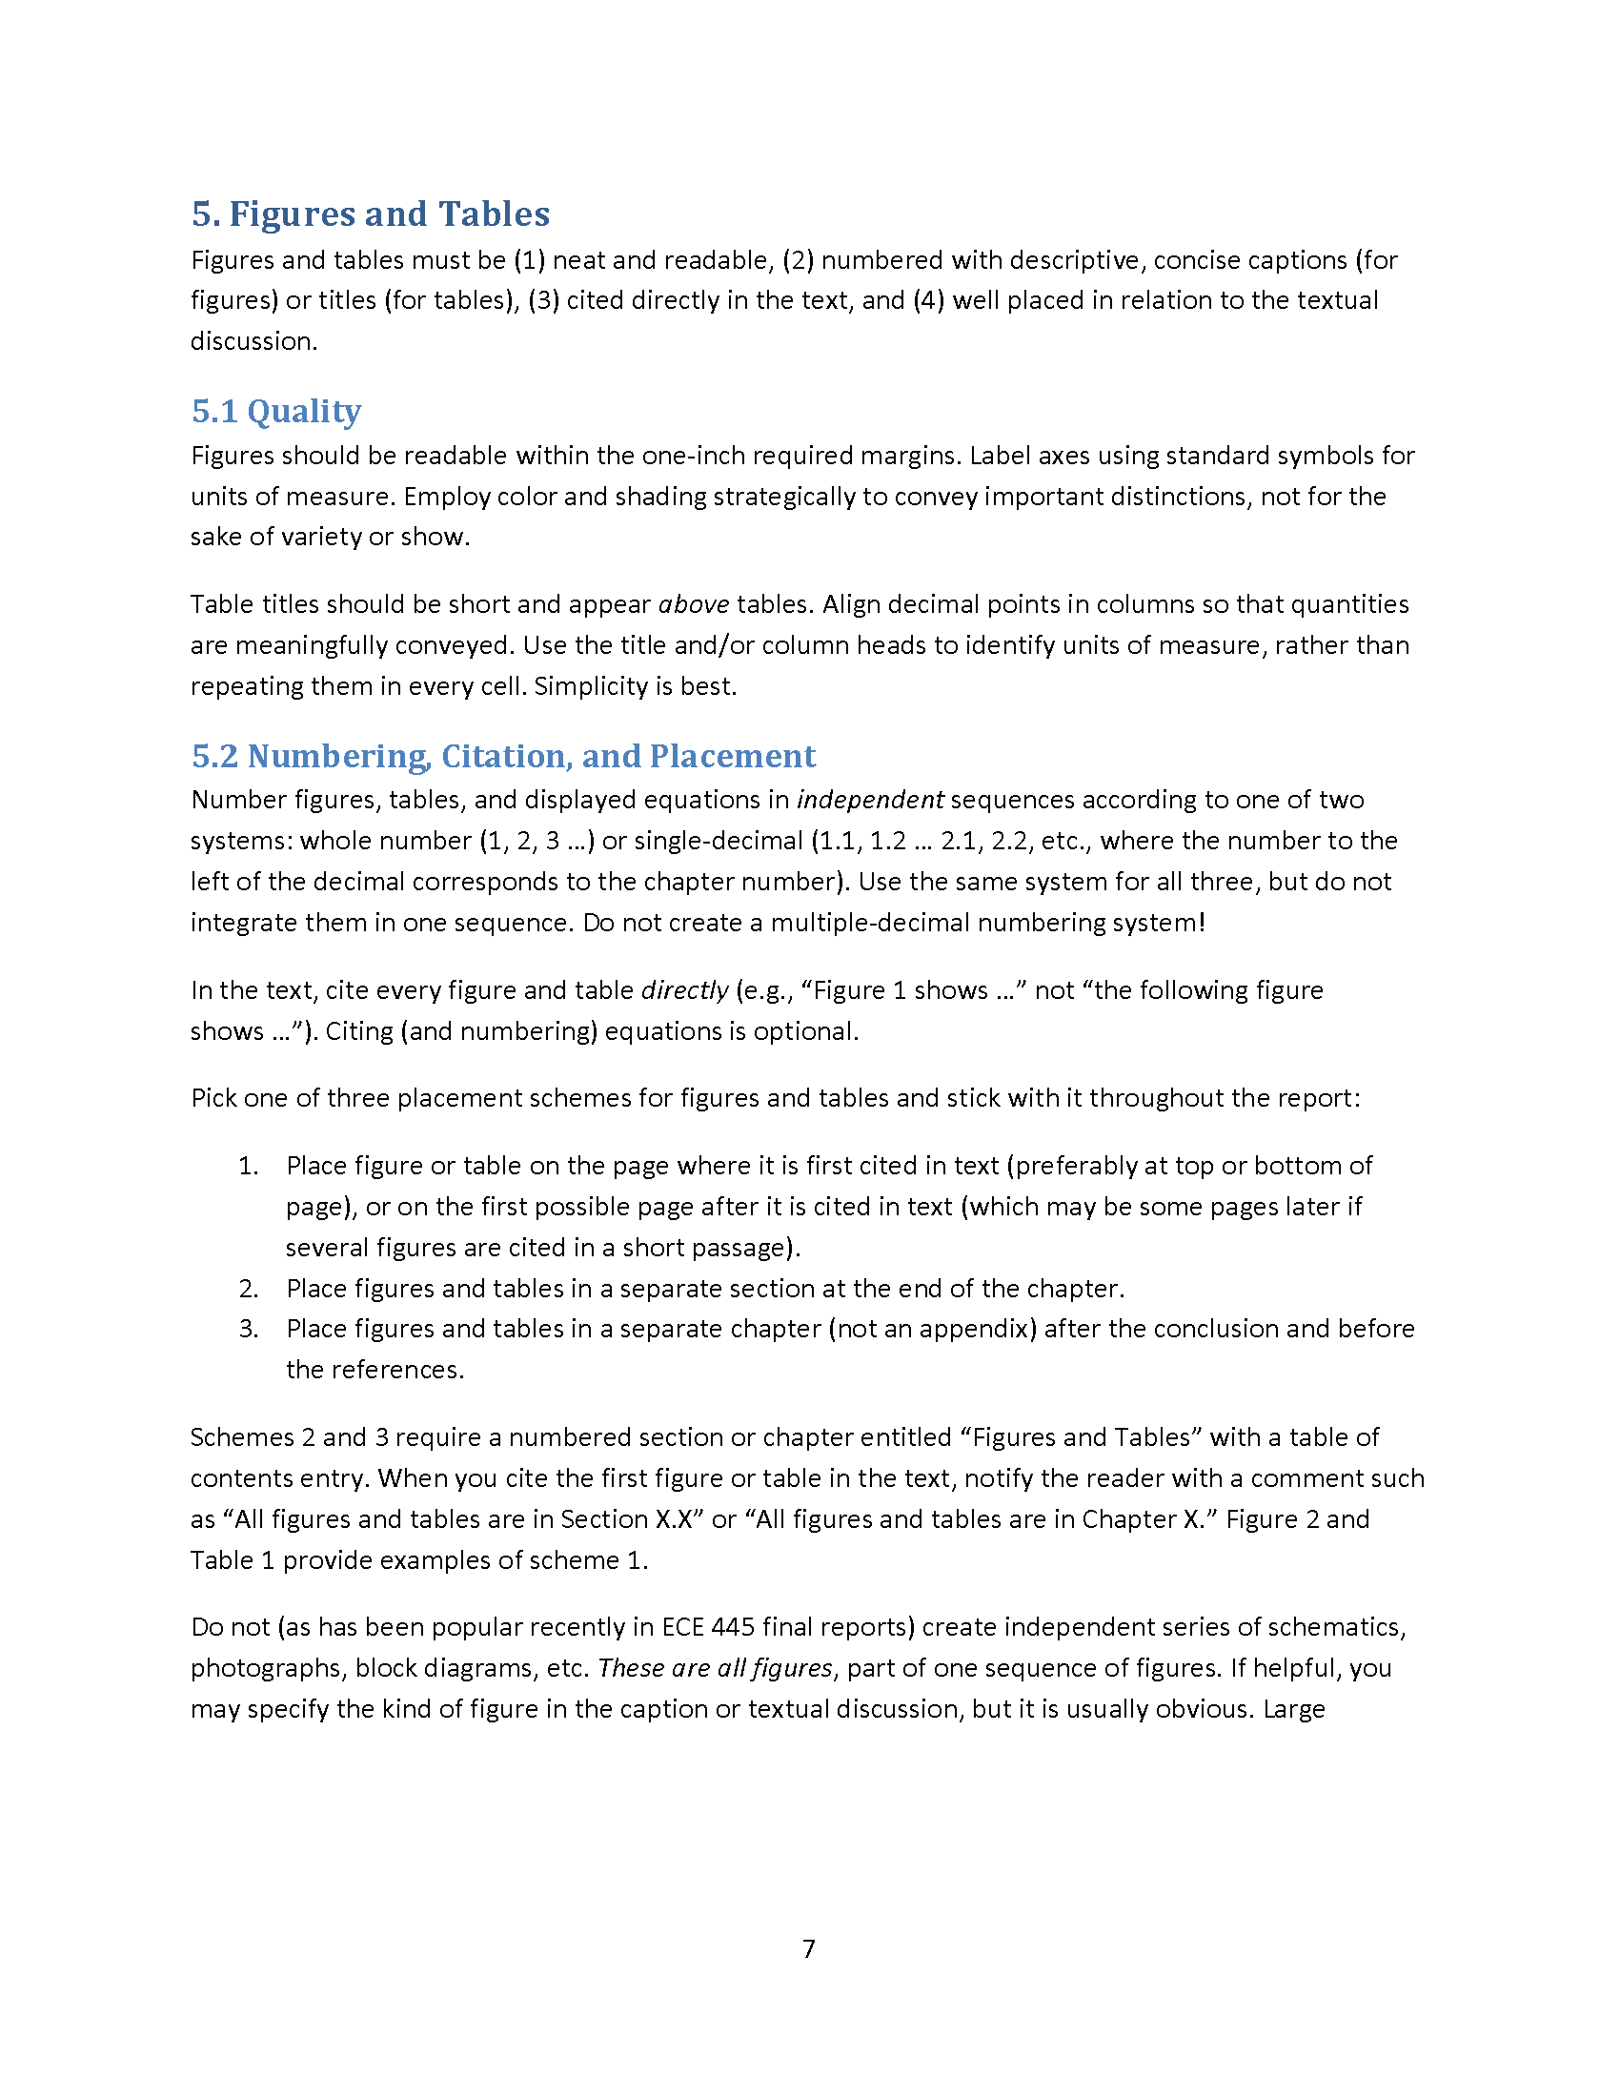

Slide 13
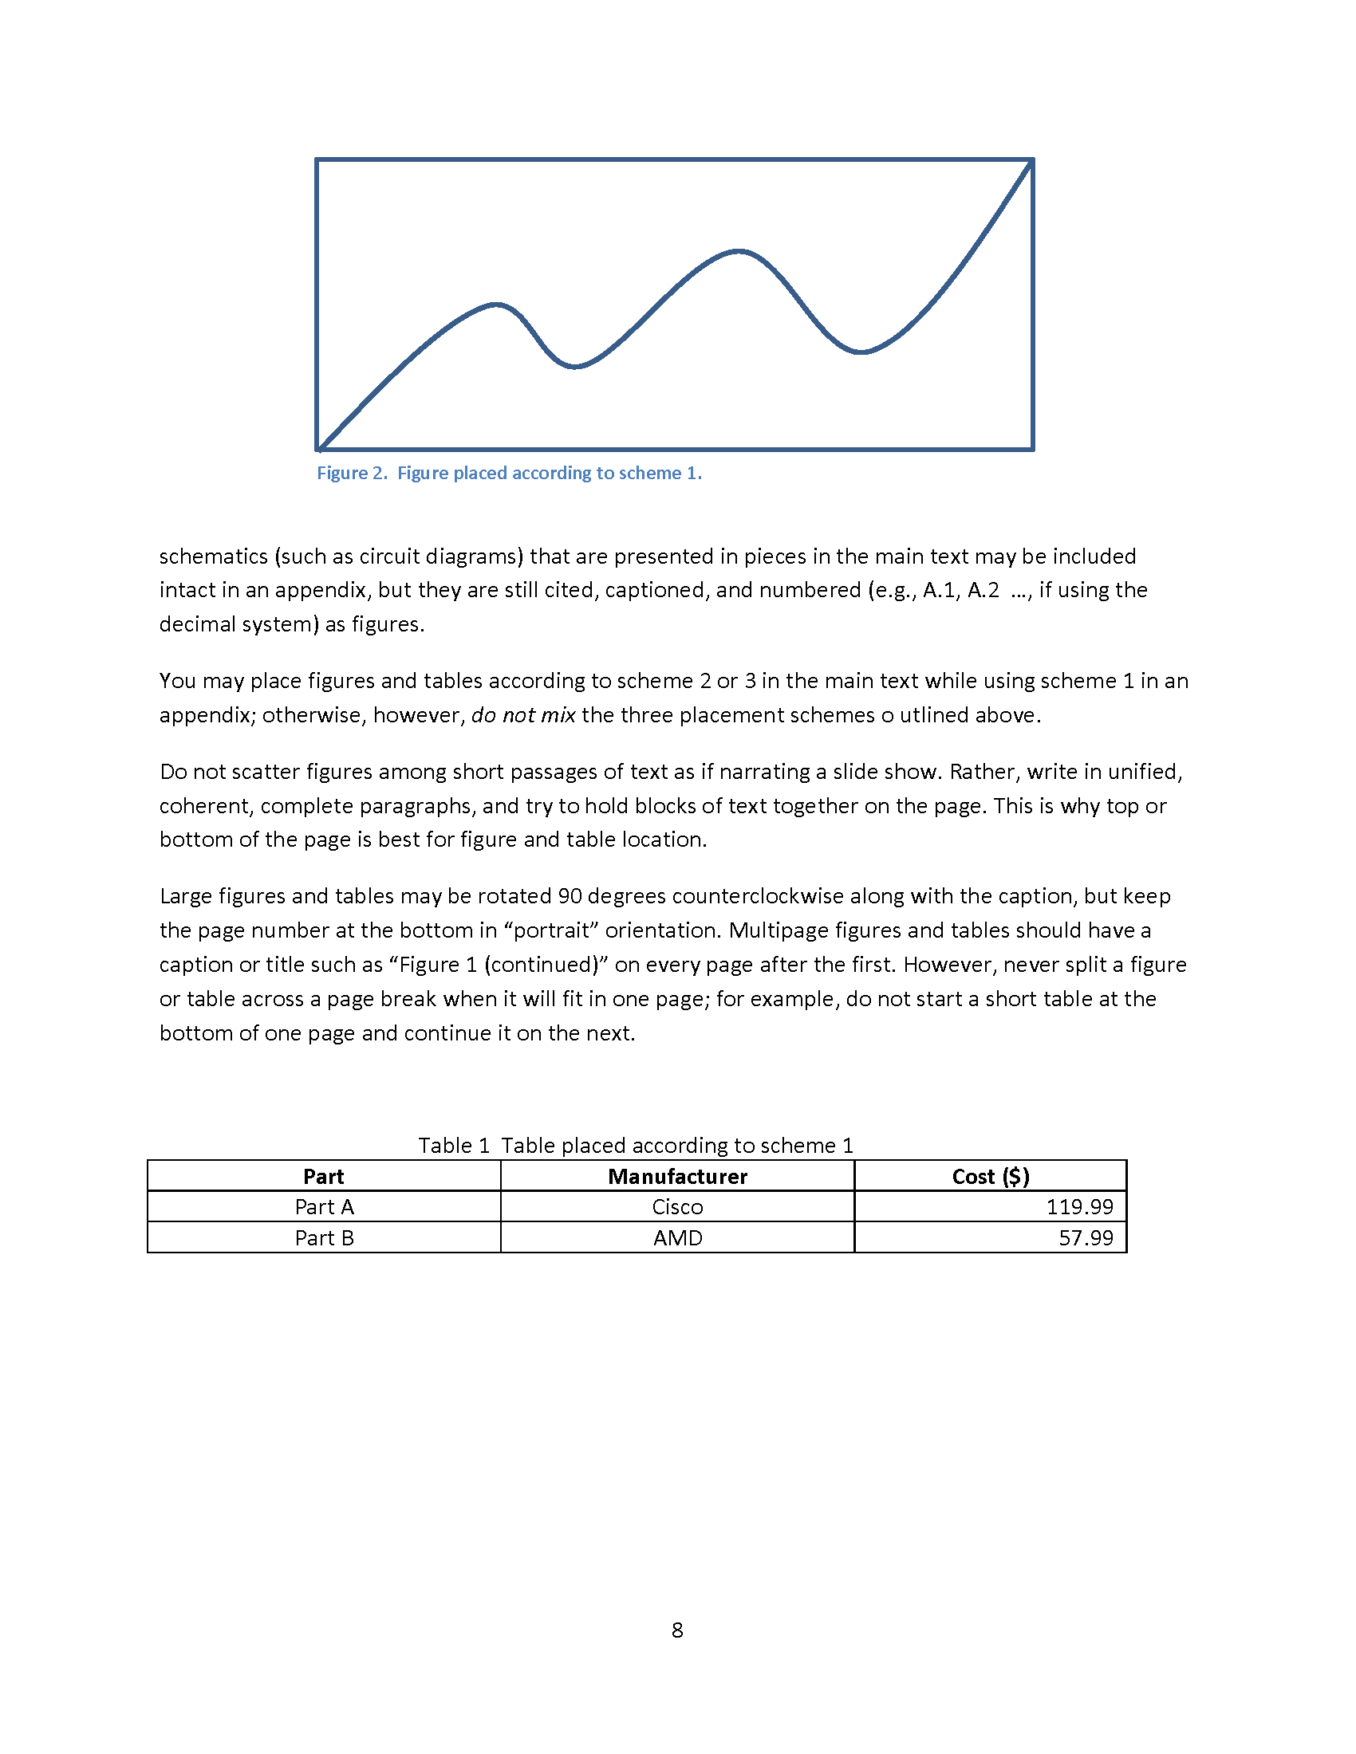

Slide 14
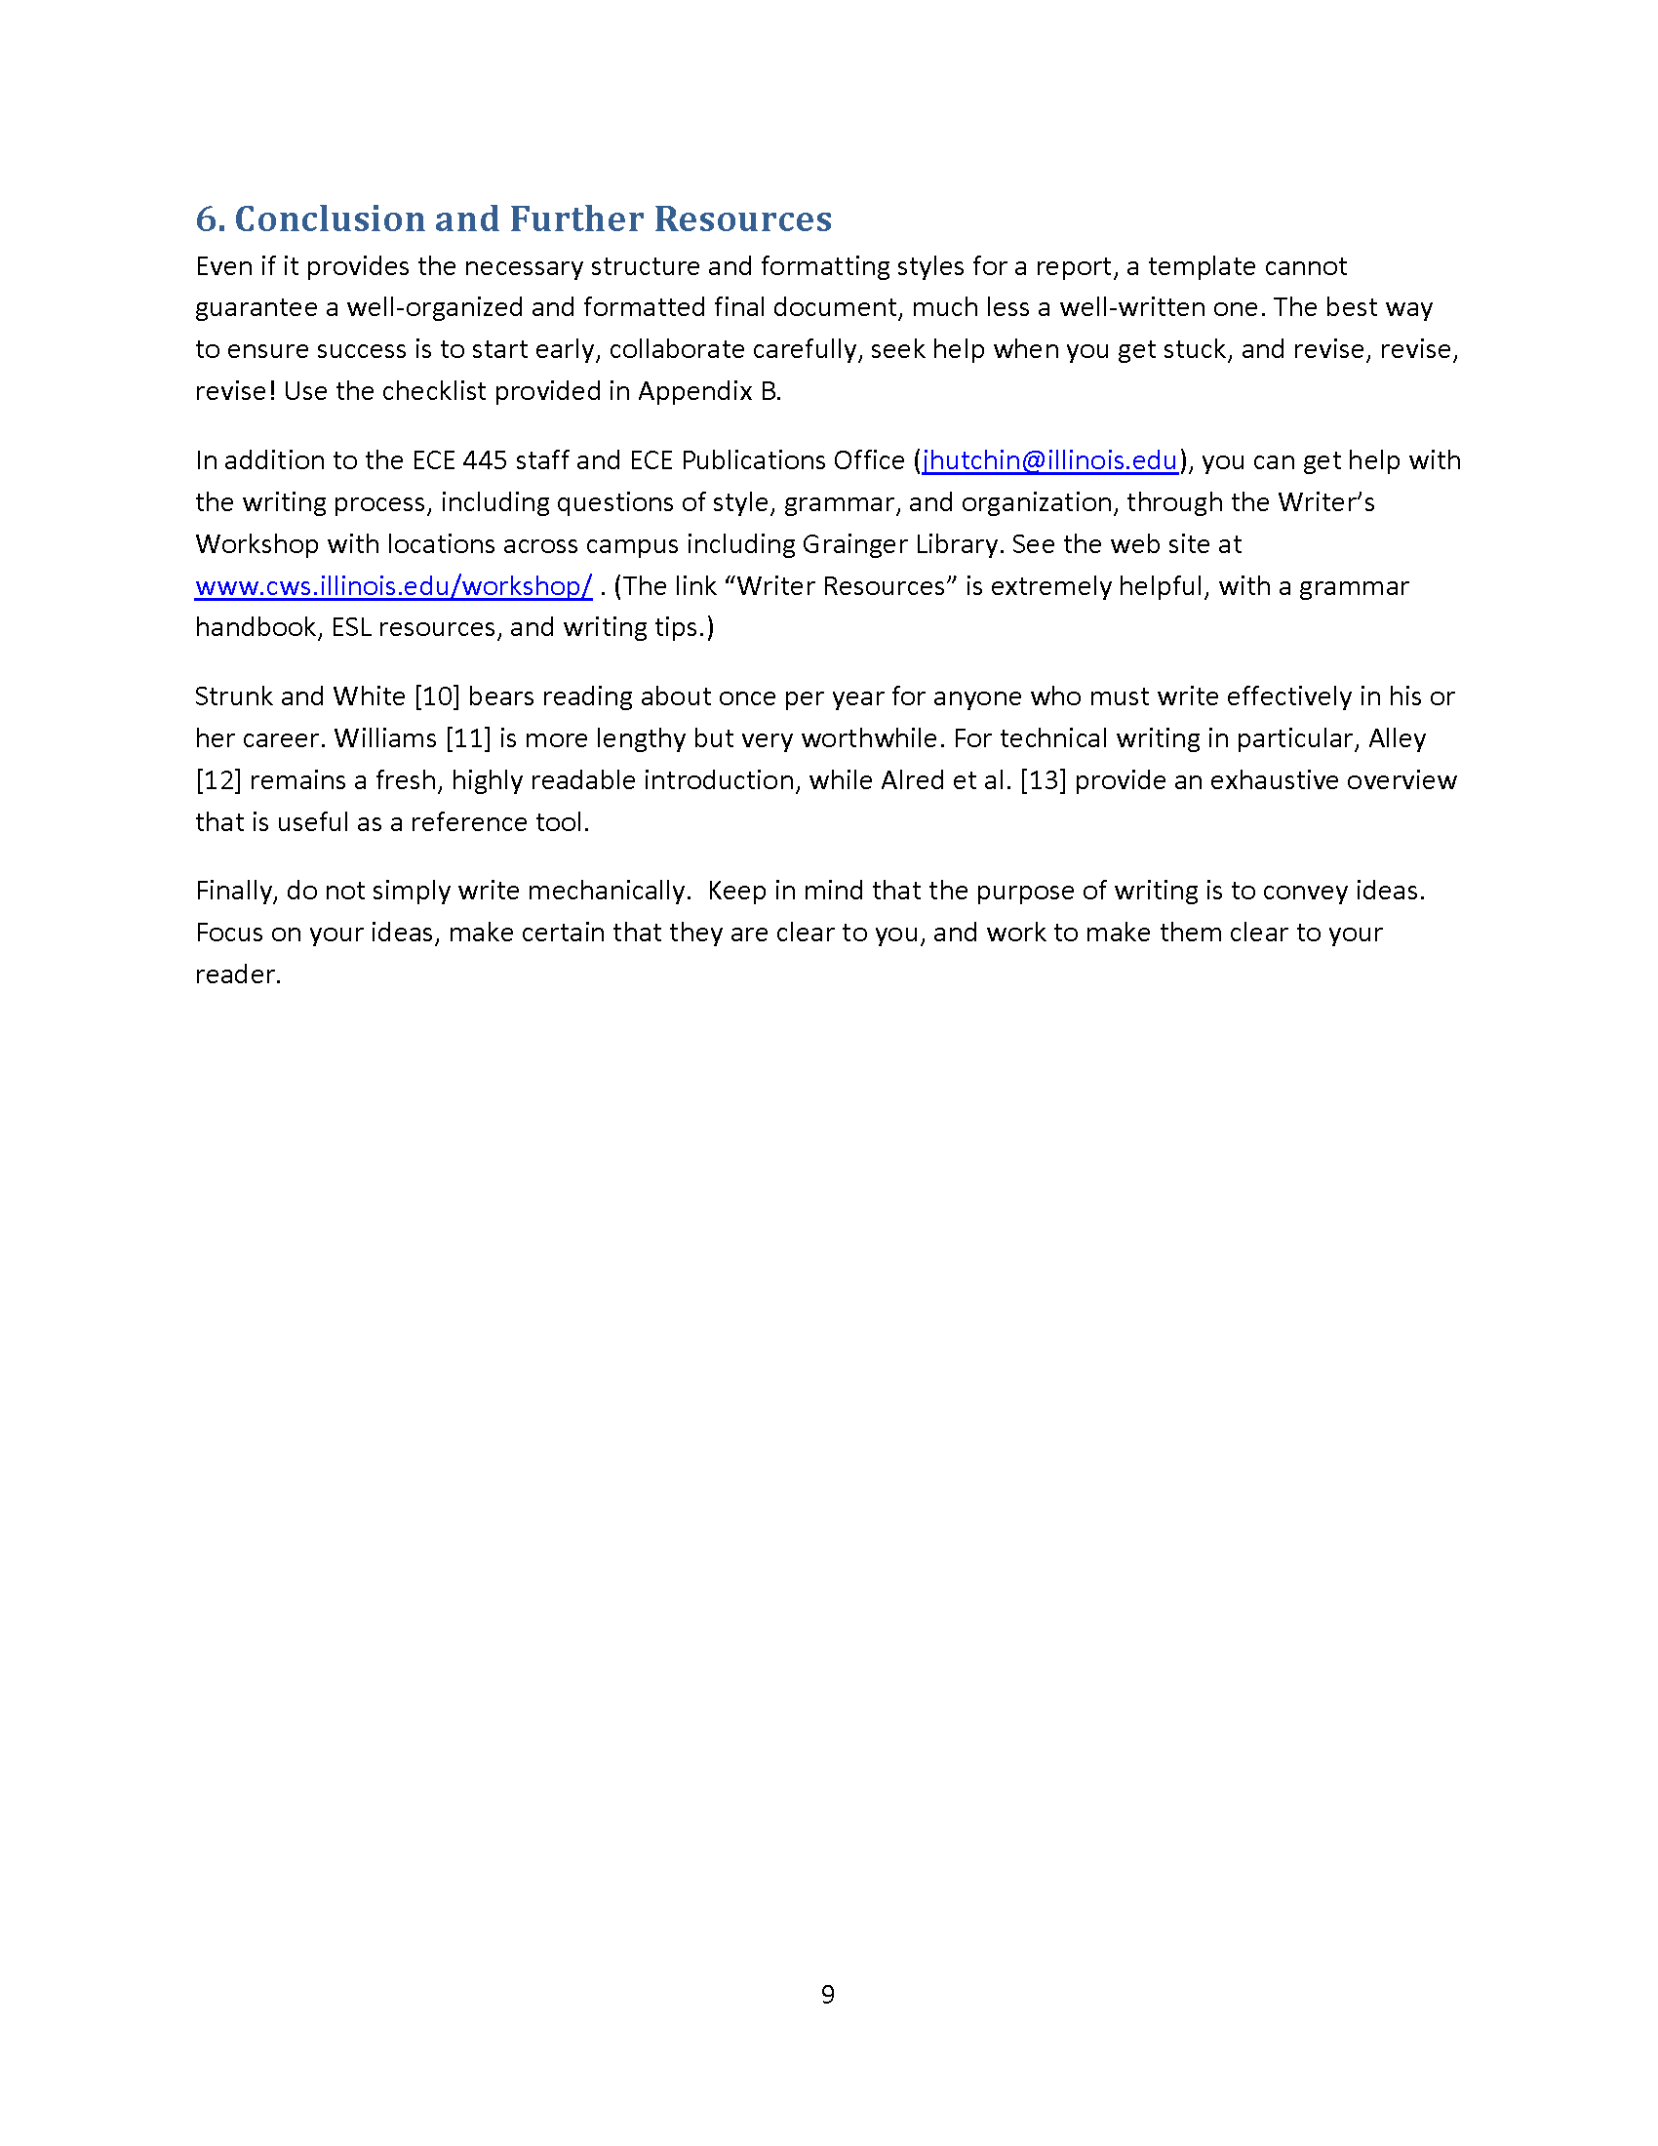

Slide 15
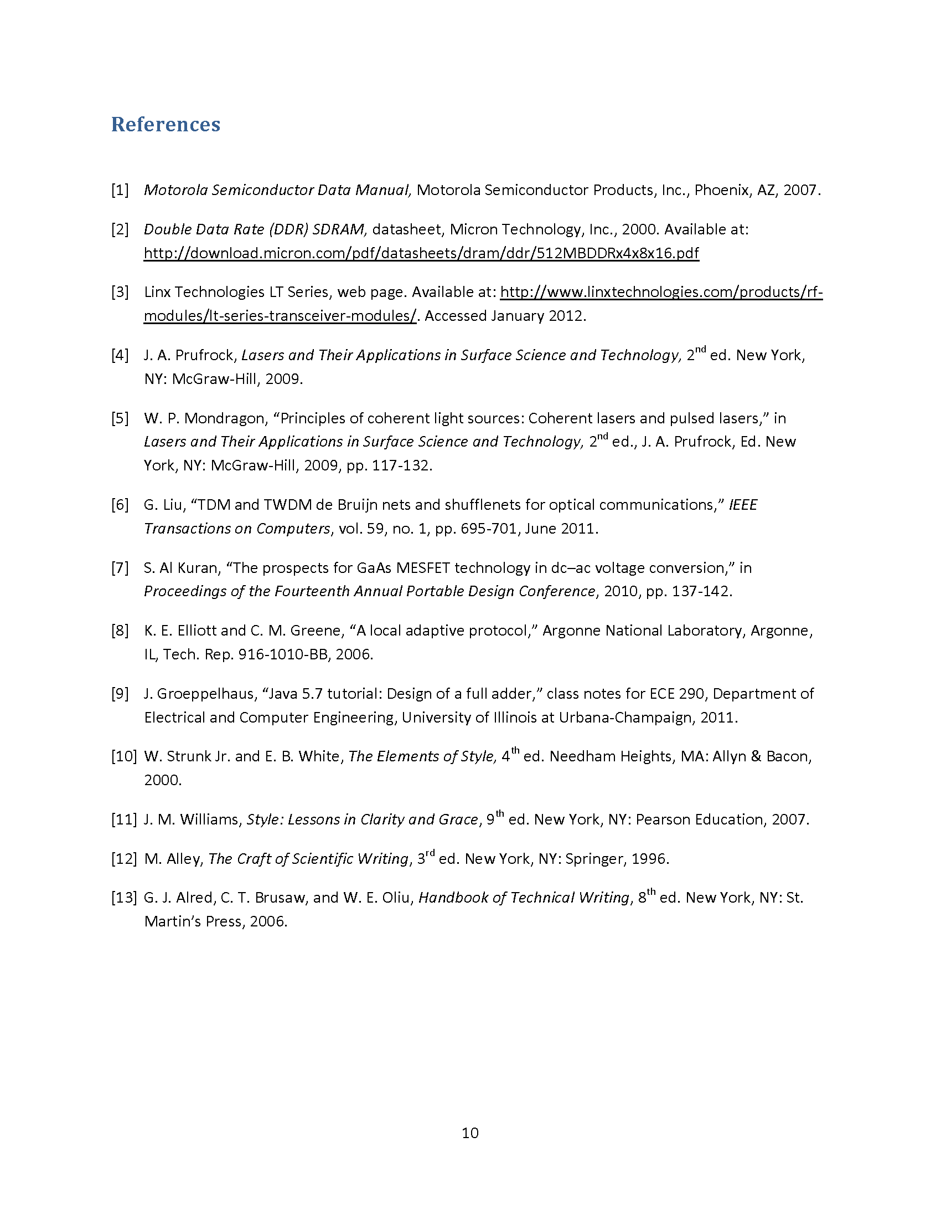

Slide 16
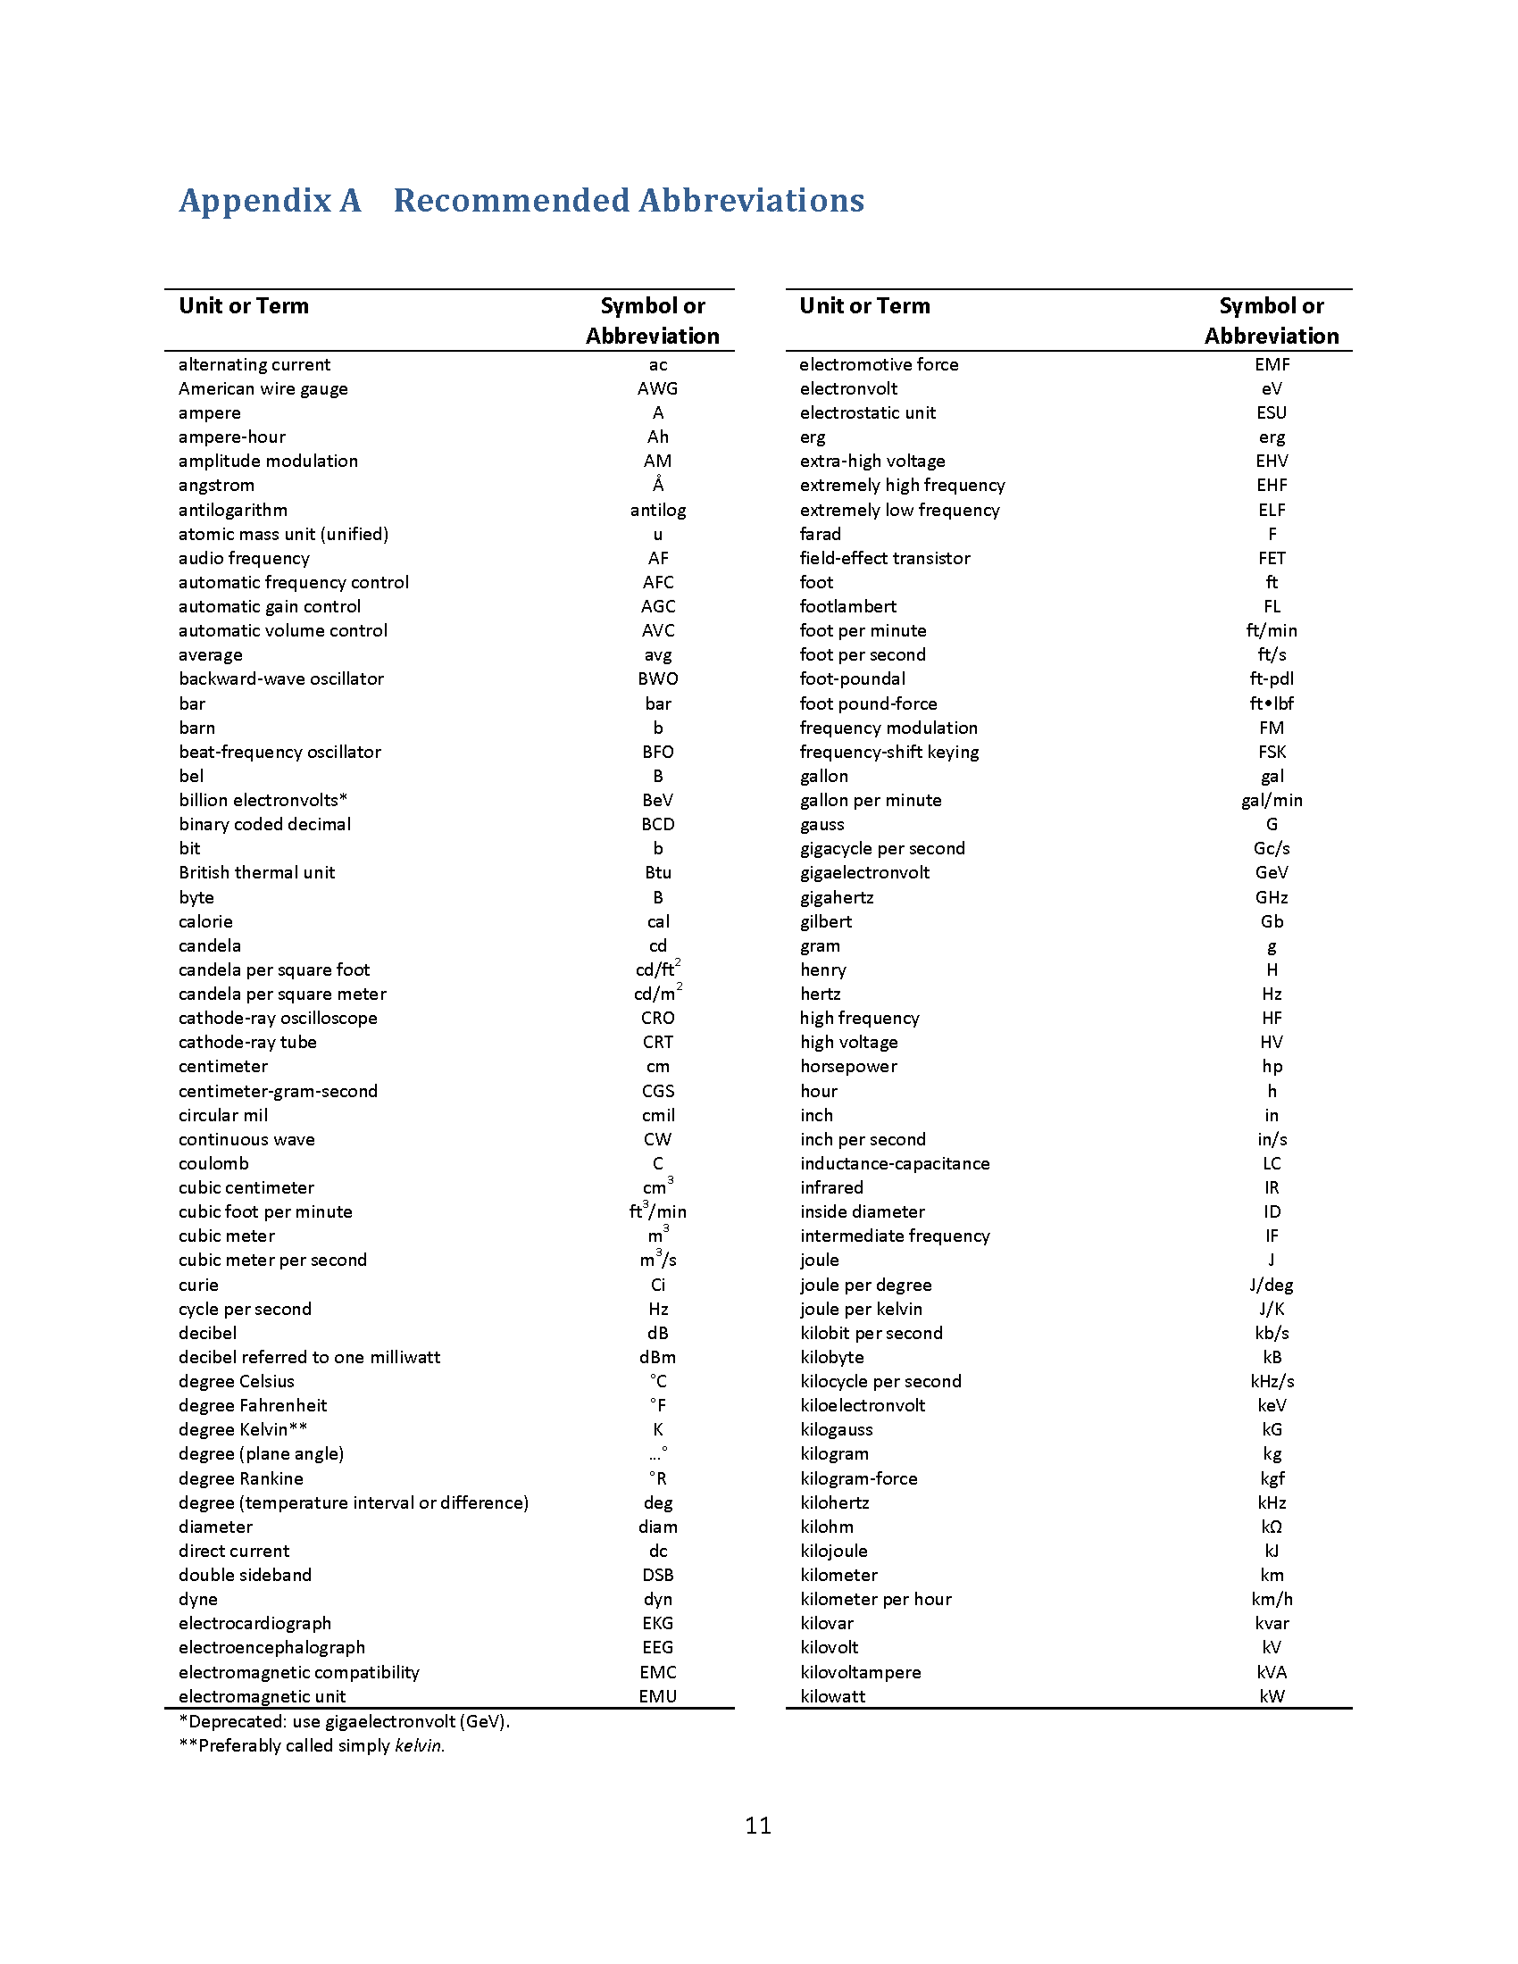

Slide 17
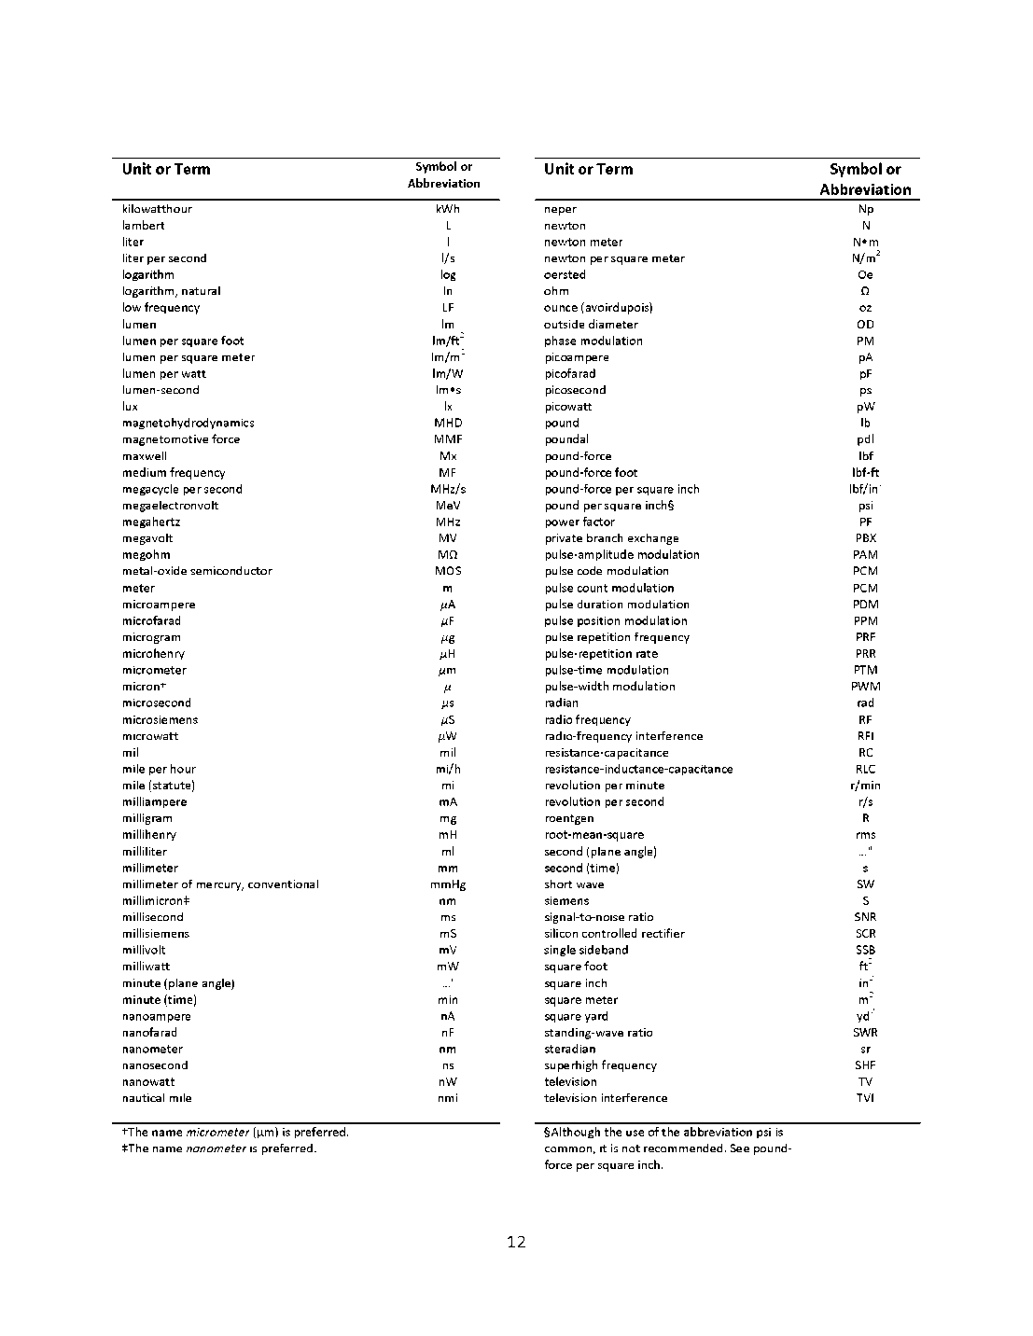

Slide 18
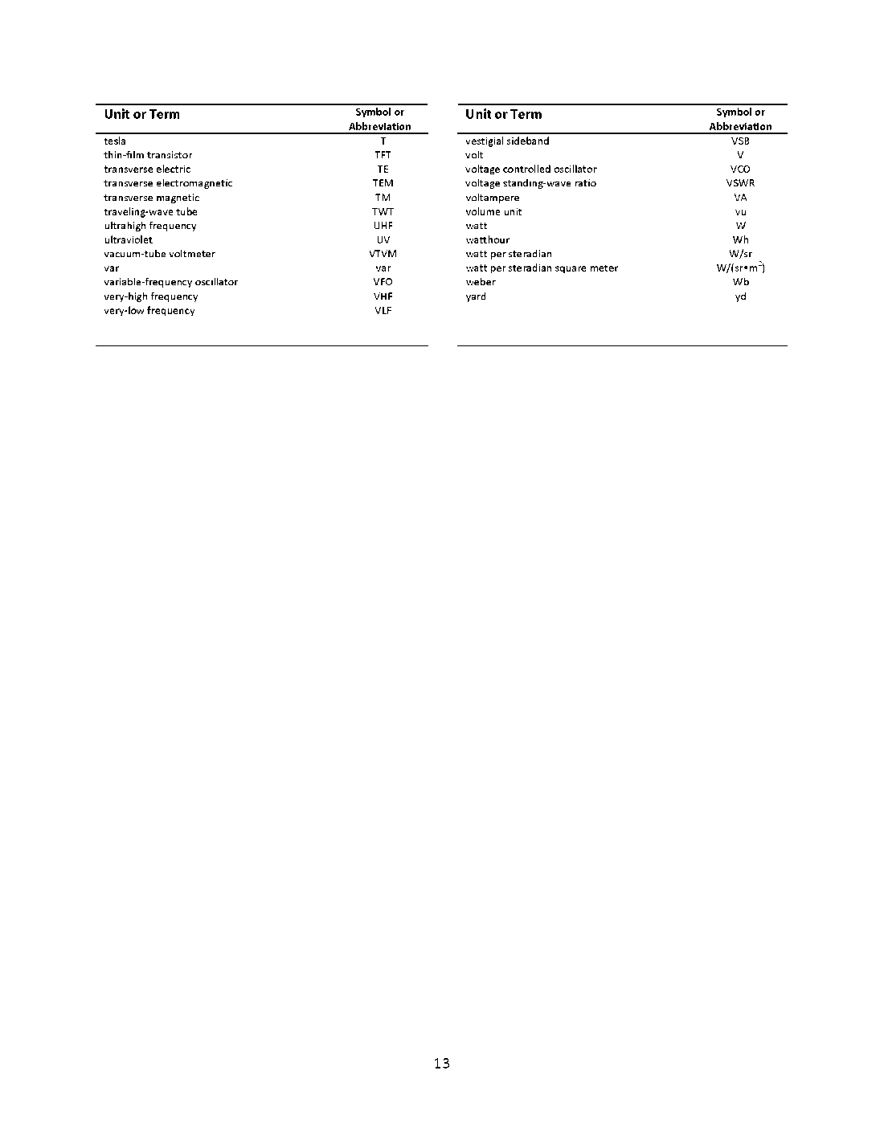

Slide 19
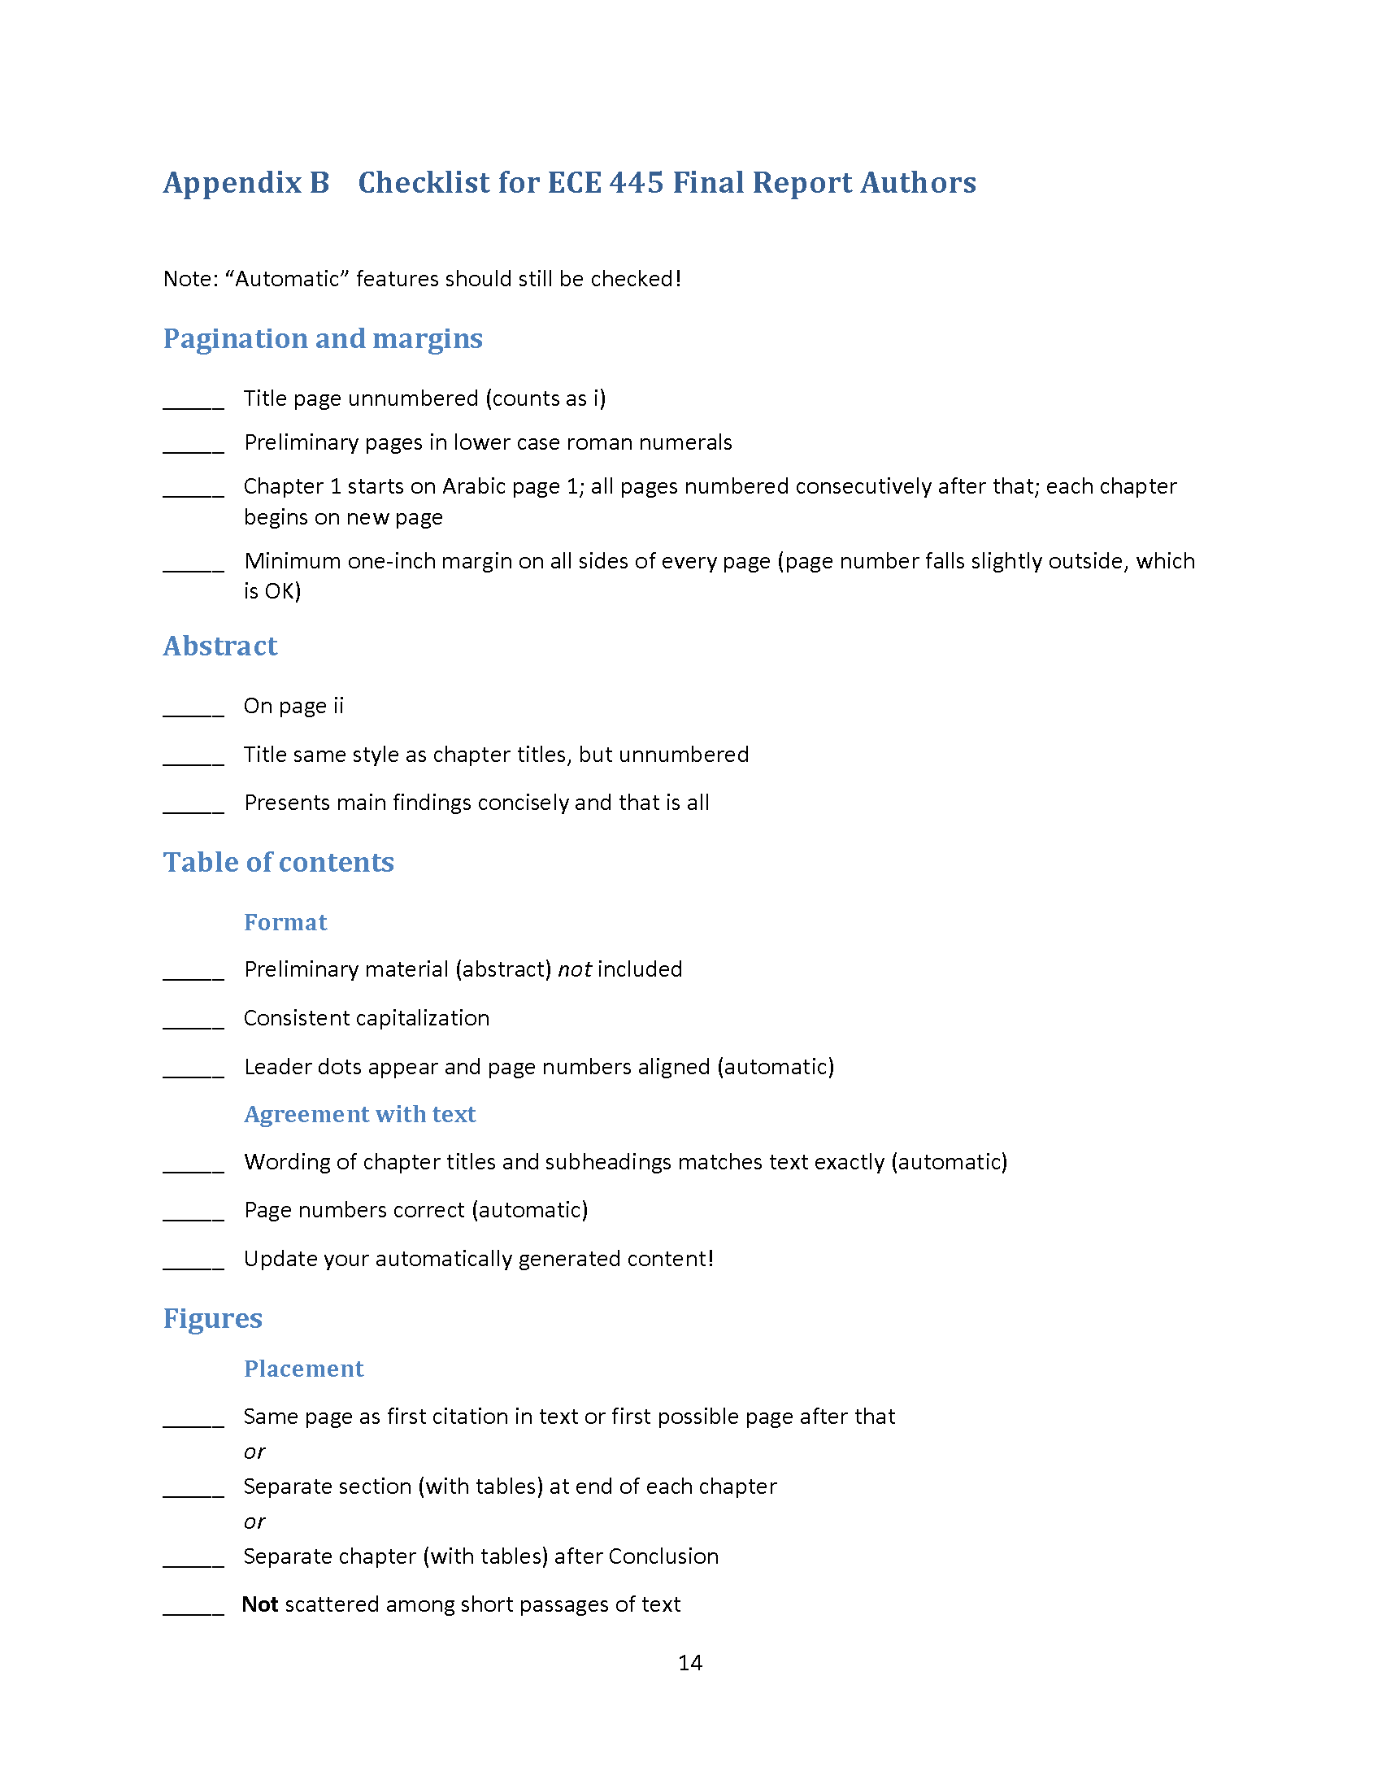

Slide 20
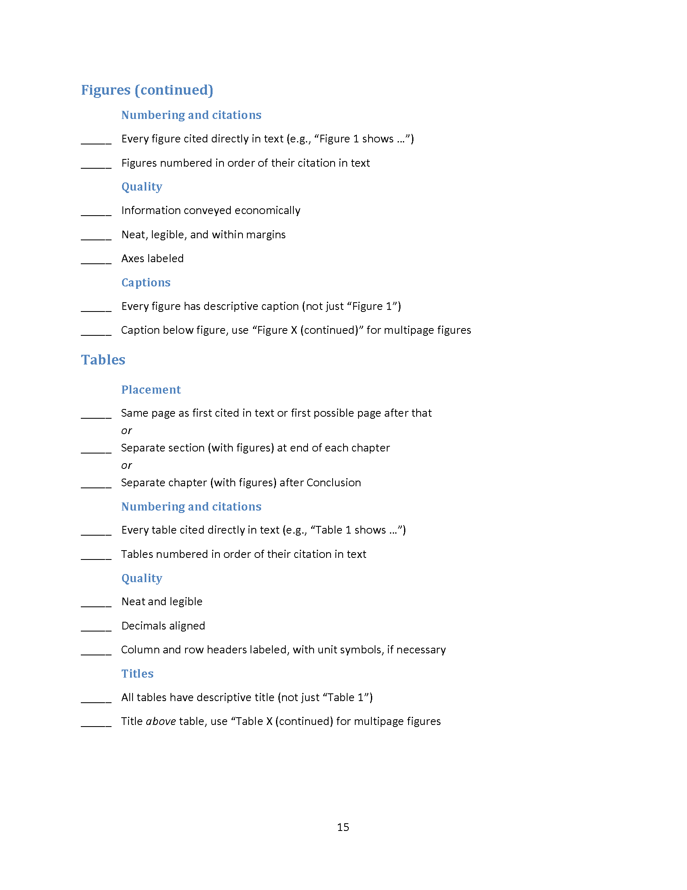

Slide 21
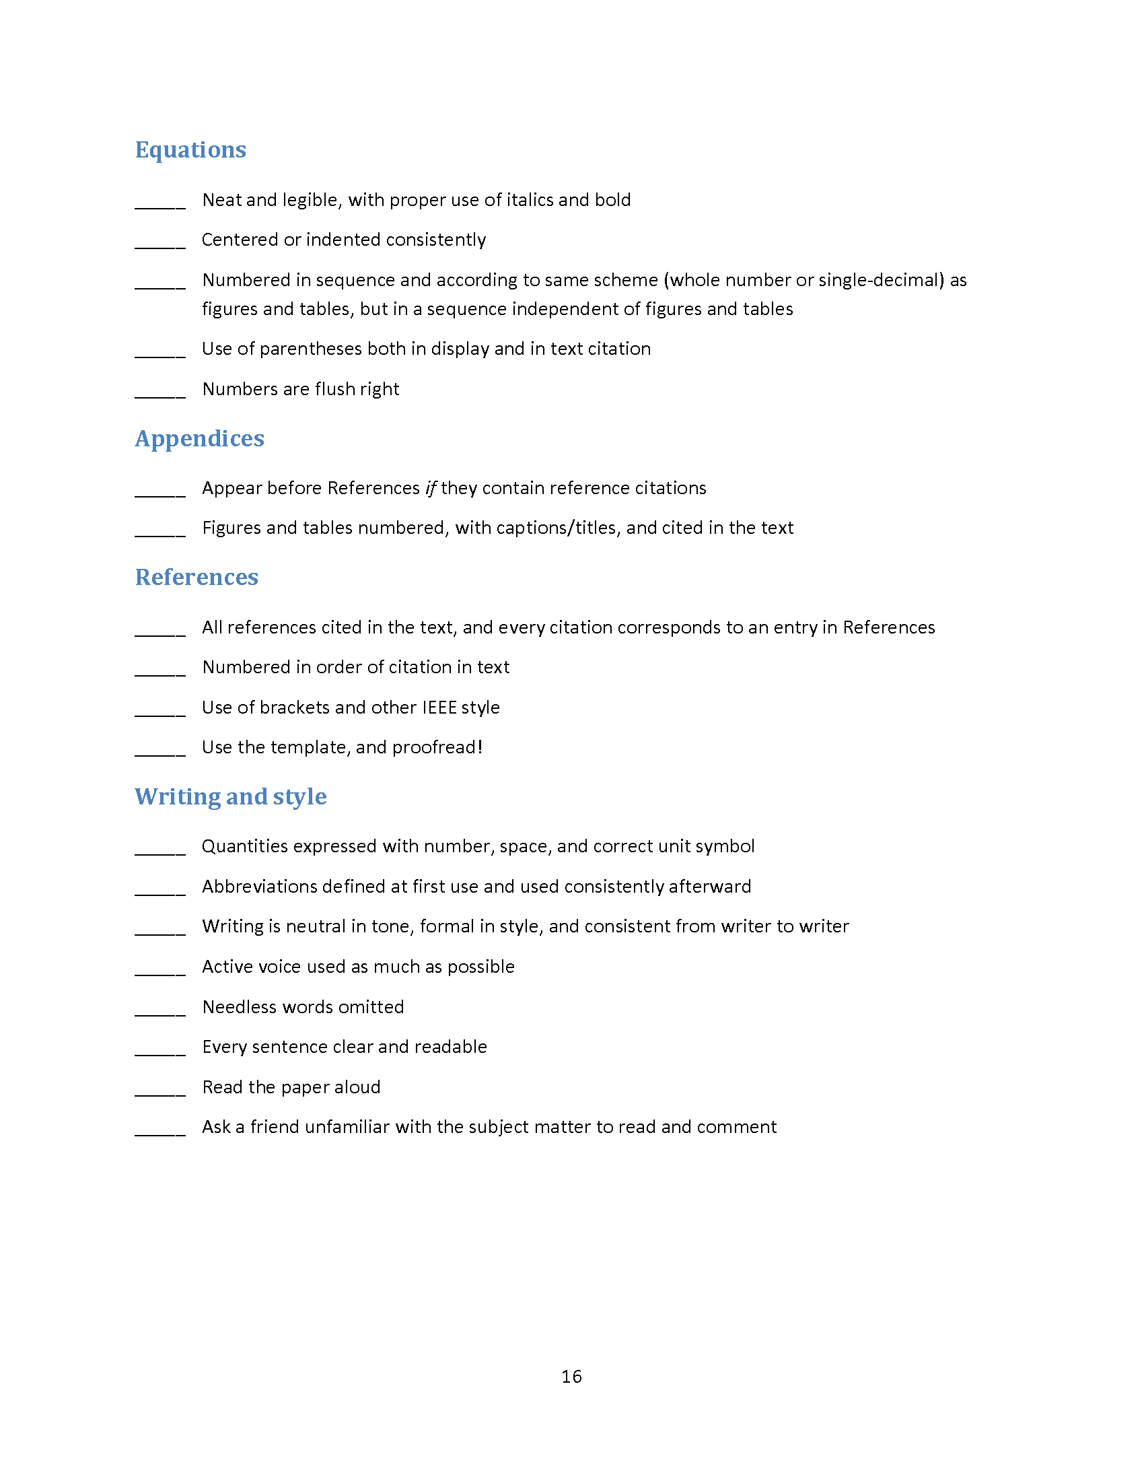

Slide 22
Abstract
Provide 150 words, or less, briefly describing the function and overall design of your project along with main results.
Avoid introductory material such as background, competitors, and motivation—save that for Introduction.
Don’t give a sales pitch.
Do not include in Table of Contents.

Slide 23
Table of Contents
Neat and complete
Reader-friendly: uses leader dots
Accurately reflects headings
Accurately reflects page numbers
Consistent depth (chapter titles, sections, subsections)

Slide 24
Figures and Tables
Three placement options:
Same page as first citation in text, or first possible page after
Separate section at end of each chapter
Separate chapter (not an appendix) at end of main text
Pick one style for the entire report.

Slide 25
Figures and Tables
Cite every figure and table directly in the text (e.g.: “Figure 1 shows …” not “The following schematic shows …”).
Number figures in order of their citation in text.
Use whole number (1,2,3 …) or single-decimal (1.1, 1.2, … 2.1, 2.2 …) system.

Slide 26
Figures and Tables
Convey the information economically.
Make them neat and legible, and stay within 1-inch margins.
Label axes, rows, columns.
Write neat, concise captions.

Slide 27
Figures and Tables
As much as possible, anchor them at tops and bottoms of pages with text wrapping.
Do not pin them to text citations, resulting in scattered figures interspersed with short passages of text—as if narrating a slide show.

Slide 28
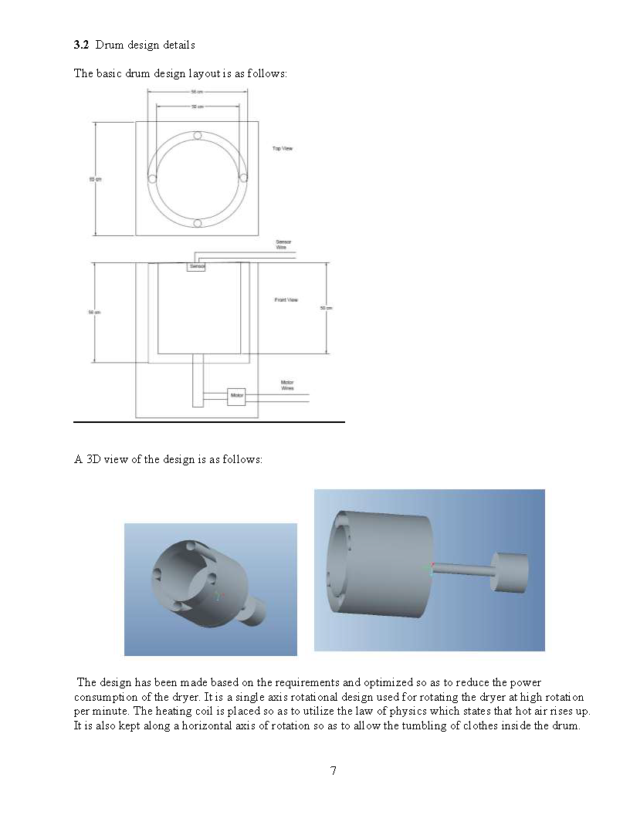

Slide 30
Appendices
Reserve for detailed technical material that, while it may be important, is secondary or would disrupt the project description of the main text.
Examples: Requirement & verification table (required), large data tables, lengthy code, sets of schematics, etc.

Slide 31
References
Numbered
Neat, complete, consistent
Cited in the text
“According to Smith [1], a major design consideration is …”
“The PIC16F87A data sheet [1] specifies …”

Slide 32
Miscellaneous
Consistent voice for multiple authors
Use “we,” not “I,” “Mary,” etc.
Pagination
Title page, preliminary pages, main text
Page flow
Start each chapter on new page
Otherwise, avoid big white spaces
Distinguish tables and figures
Avoid “brain dump” with too much detail

Slide 33
Spring 2020 (score ≥ 19.5)
Recent Exemplary Final Reports
(Format and English Only)
Fall 2020
(score ≥ 19)
Team 23
Team 28
Team 35
Team 56*
Team 65
Team 67*
*=20
Team 4
Team 14
Team 19
Team 31

Slide 34
Optional Consultation with Editorial Staff
Email ece-thesis@Illinois.edu to schedule an optional consultation in Sept/Oct with Dr. McElroy or Taryn Smith. We will provide feedback on your design document, offer tips for the final report, and answer any questions.
Please email me to arrange a meeting: ageiger2@illinois.edu.

